Slide 1



LOVE WITH Lua
FALL IN

Slide 2


AGENDA
Installation of Sublime Editor.
Installation of Lua.
What is Lua.
Installation of Love.
What is Love?.
Game Loop.
Process Input
Update Game
Render
Lets Start Our Game.
Testing on Windows and Android.

Slide 3

SUBLIME
Sublime Text is a cross-platform source code editor with a Python application programming interface (API).
https://www.sublimetext.com/

Slide 4
INSTALLATION
https://code.google.com/archive/luaforwindows/downloads
https://www.lua.org/download.html

Slide 5
WHAT IS Lua?
Lua means “Moon” in Portuguese, Invented in 1993 in Brazil.
It’s free, small and lightweight, powerful but simple, efficient, portable.
Written using ANSI C and ANSI C++.
It’s focused around “tables”, which is same as “dict” in python and “Object” in JavaScript.
Very Popular in Game development industries.
Lua is embedded in C/C++, Ruby, Python, Java, Perl, C# etc. also available as a Simple API and library.

Slide 6














WHO USES Lua?
https://sites.google.com/site/marbux/home/where-lua-is-used

Slide 7
> > print(“Hello World!”) Hello World! > > > > >
Lua

Slide 8
COMMENTS
-- single line comment
--[[ multi
line
Comments
]]

Slide 9
VARIABLES
> a = 1 --number > b = “string” --string
> c,d = { }, function --table,function
>
>print (type(a))
number
>
>print (type(a),type(b))
number string
> > io.write (type(a), “ ”, type(b), “ ”, type(c), “ ”, type(d)) number string table>

Slide 10



Game Engines
https://sites.google.com/site/marbux/home/where-lua-is-used

Slide 11

INSTALLATION
https://love2d.org/
https://love2d.org/wiki/Getting_Started

Slide 12

WHAT IS ?
fast and easy to use 2d game development framework written in C++.
Uses Lua as its scripting language.
Contains so many modules which help us to create our 2d game easily i.e. graphics, physics, math, audio, keyboard and much more.
Completely free and portable to all major desktops and Android/OS.
Great for prototyping!

Slide 13
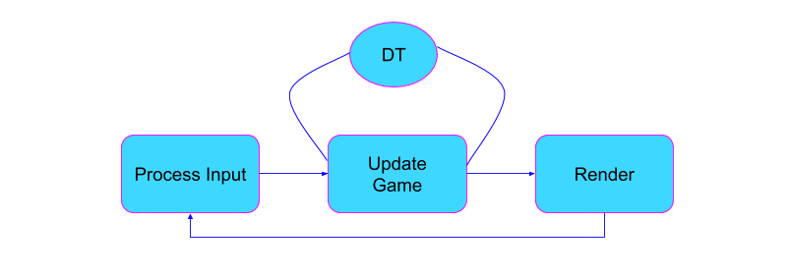
GAME LOOP

Slide 14
PROCESS INPUT
function love.load()
x = 0
y = 0
end

Slide 15
UPDATE GAME
function love.update(dt)
x = x + 1
y = y + 1
end
dt = delta time
60 frames per second

Slide 16
RENDER
function love.draw()
love.graphics.print(“Hello World!”, x, y)
end

Slide 17
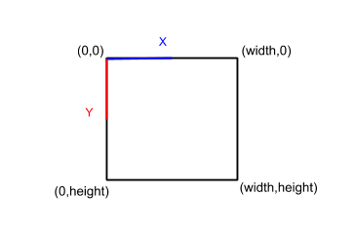
2D COORDINATE SYSTEM

Slide 18
RENDER
function love.draw()
love.graphics.rectangle(“fill”, x, y, 50,50)
end

Slide 19


Slide 20
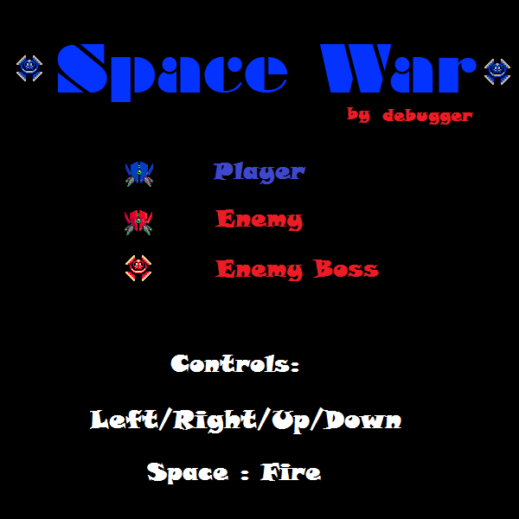

Slide 21
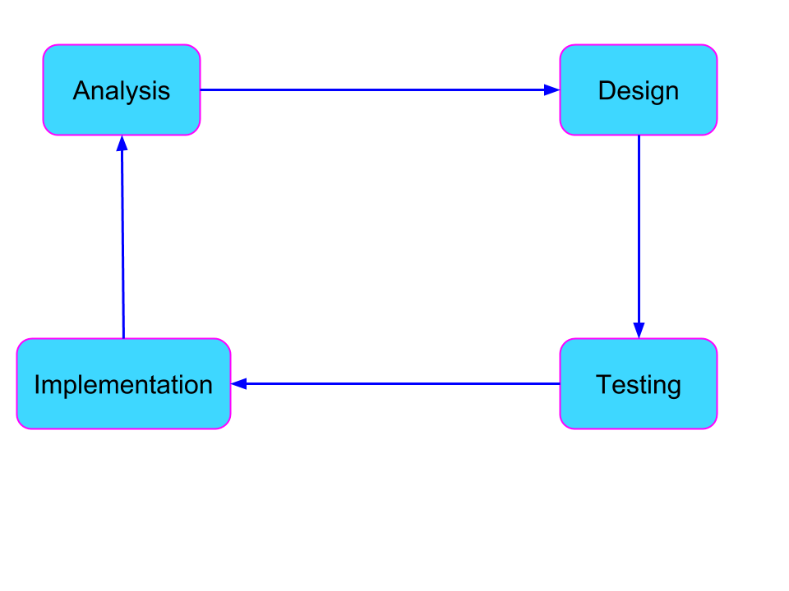
BASIC PHASES OF GAME DEVELOPMENT

Slide 22
Space War
We are going to complete this game in some phases or steps.

Slide 23
Space War
https://github.com/TheTuringClub/Fall-In-Love-With-Lua/

Slide 24
Space War
Game Characters:

Slide 25
Space War
Controls:
LEFT
RIGHT
FIRE

Slide 26
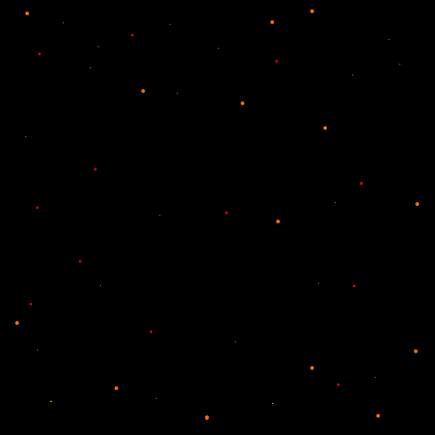
Space War
Background

Slide 27
Space War
Lets Begin

Slide 28
Space War
Testing On windows and android.
https://qubodup.itch.io/startgamedev
http://stabyourself.net

Slide 29
Space War
Examples
http://stabyourself.net

Slide 30




Contact me
https://github.com/bhattsameer
https://www.linkedin.com/in/bhatt-sameer/
@sameer_bhatt5
bhattsameer5@gmail.com

Slide 31


